Slide 1

Online Book Store
Submitted By-
Gitanjali Tiwari
Soni Jha
Saloni Sharma
Shrishti Sharma

Slide 2
AGENDA
Introduction
System Specifications
Tools and Technology Used
Diagrams
Demonstrating Workflow
Conclusion
Future Scope
References
Q & A

Slide 3
-Introduction
Online Book Store is an e-Library website that has a collection of books from some of India’s best publishers.
The website is for everyone and has books both in English and Hindi. It is a service that connects you to the stores in your neighborhood.
Order with few taps and get everything delivered at your doorstep, instantly.
You can shop from a wide assortment of books from various authors and different genres.
The friendly website provides easy modes of payment through cash-on-delivery, online payment through debit/credit cards.

Slide 4
System Specification
OS | Windows
Browser | Chrome , Firefox
RAM | 4GB
Hard Disk | 500 GB

Slide 5
Tools and Technology Used
Front End Languages | HTML,CSS,Javascript and Ajax, jQuery
Back End Languages | Asp.net core MVC ,SQL server Web API
Database | Sql Server
IDE | Visual Studio

Slide 6
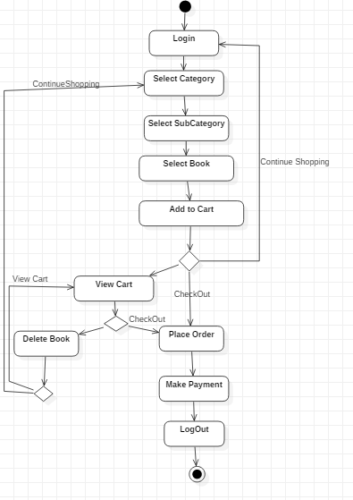
Activity Diagram

Slide 7
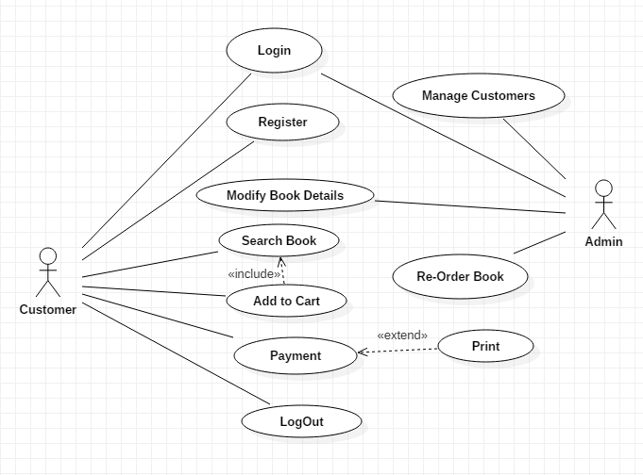
Use Case Diagram

Slide 8
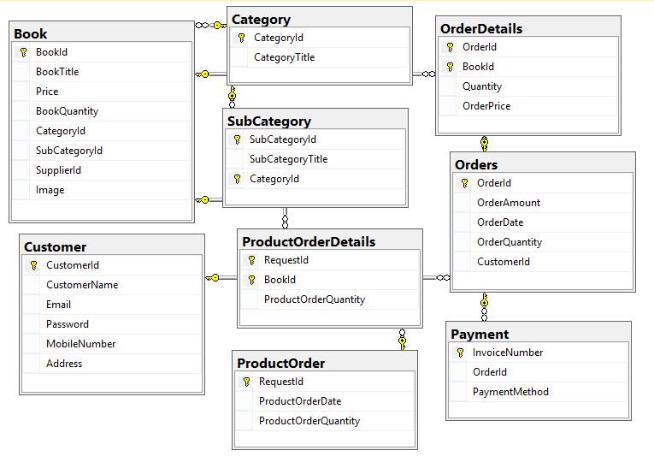
Database Diagram

Slide 9
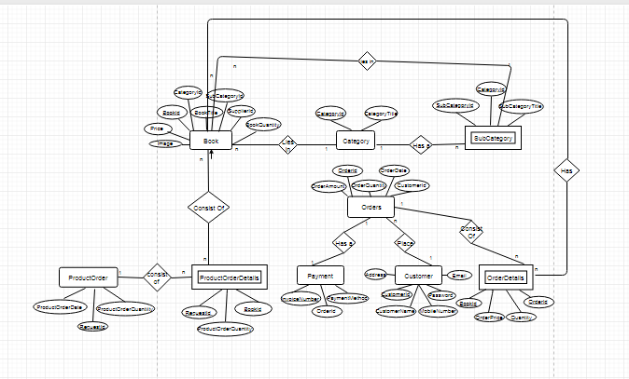
Entity Relationship Diagram

Slide 10
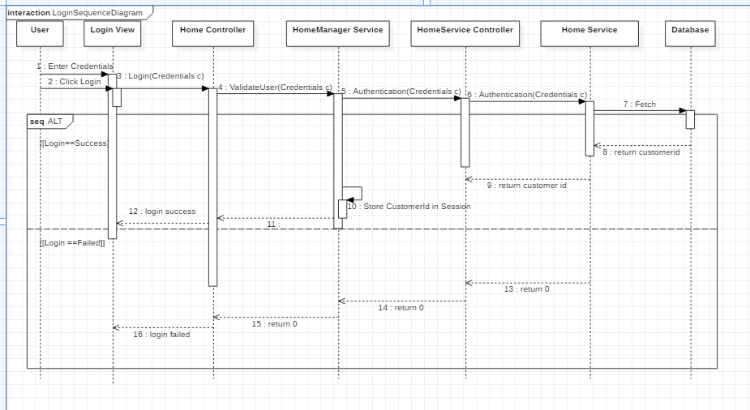
Sequence Diagram(Login)

Slide 11
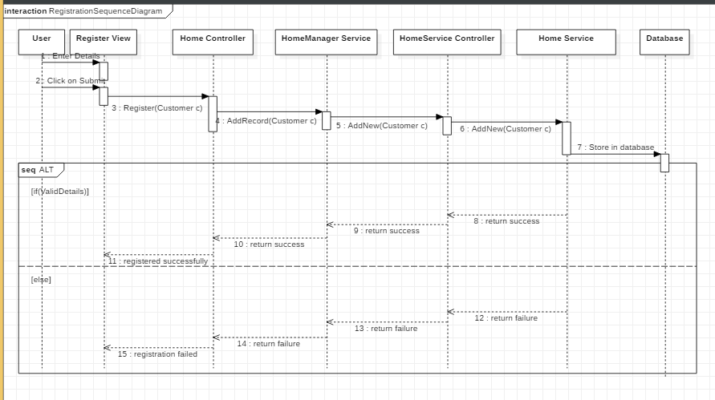
Sequence Diagram(Register)

Slide 12
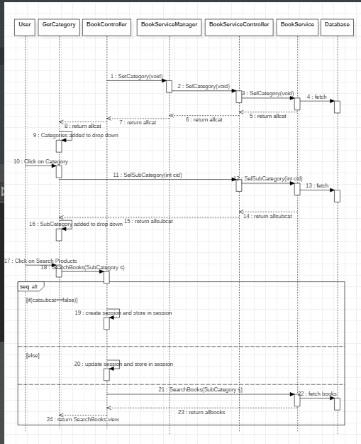
Sequence Diagram(Search Books)

Slide 13
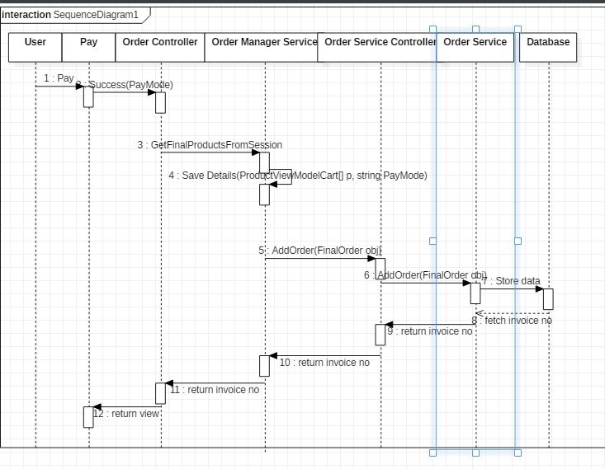
Sequence Diagram(Payment)

Slide 14
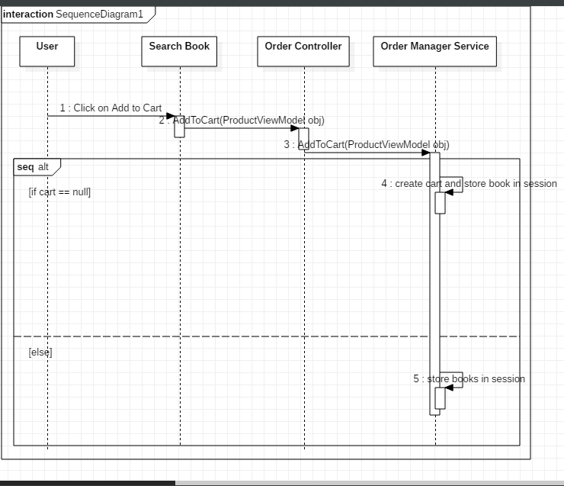
Sequence Diagram(Add to Cart)

Slide 15
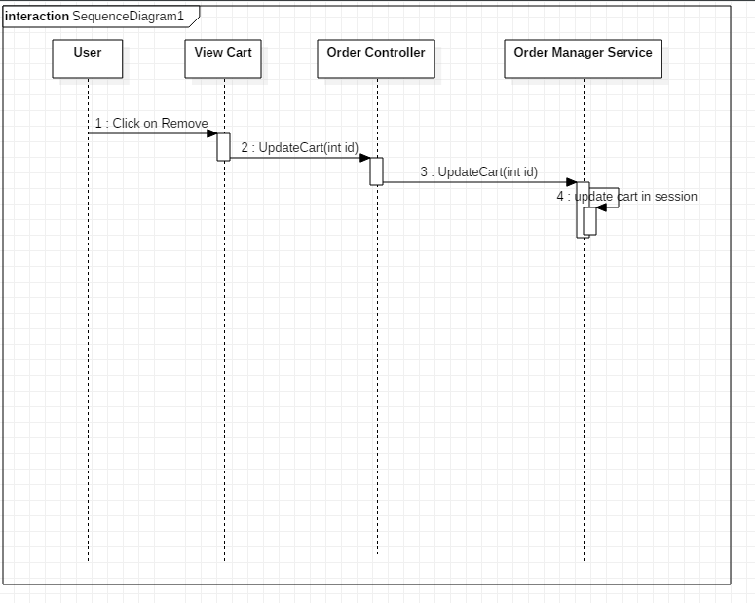
Sequence Diagram(Update Cart)

Slide 16
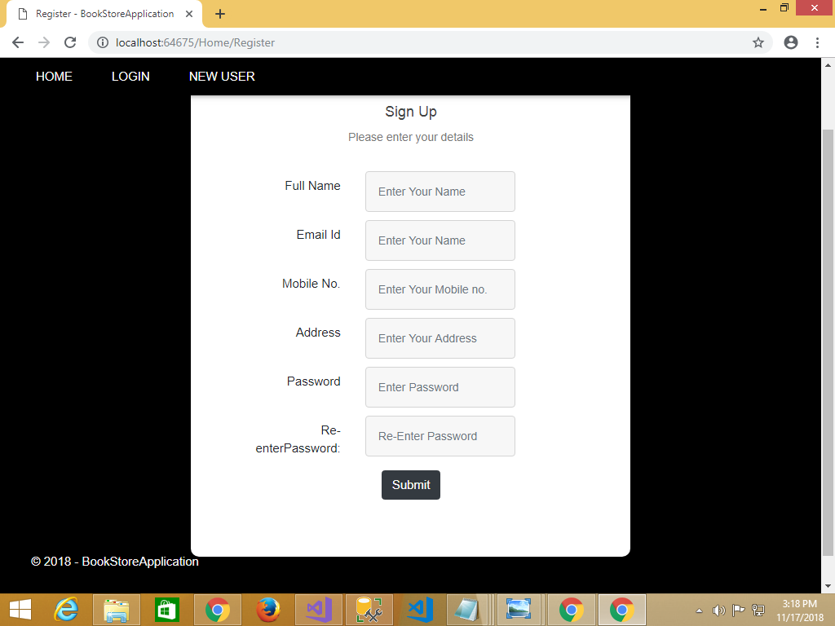
Signup

Slide 17
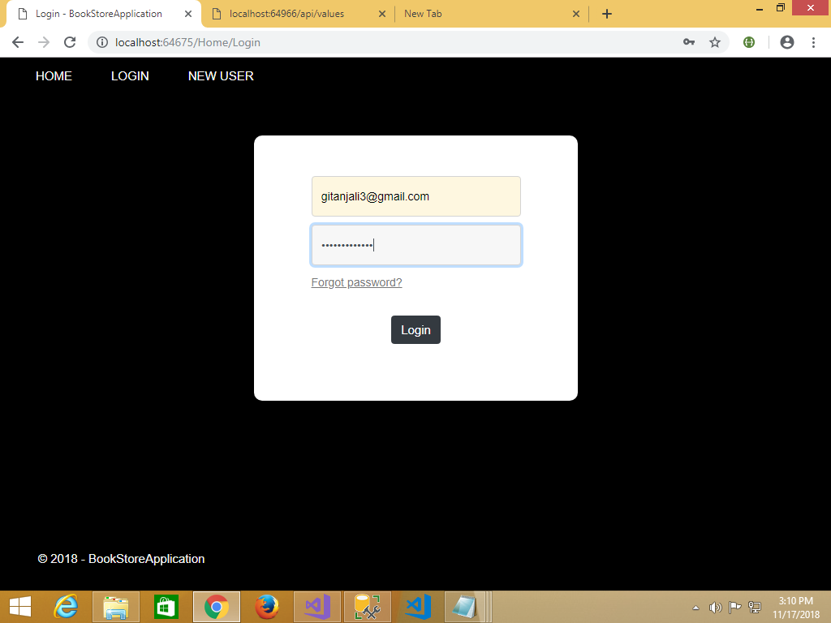
Login

Slide 18
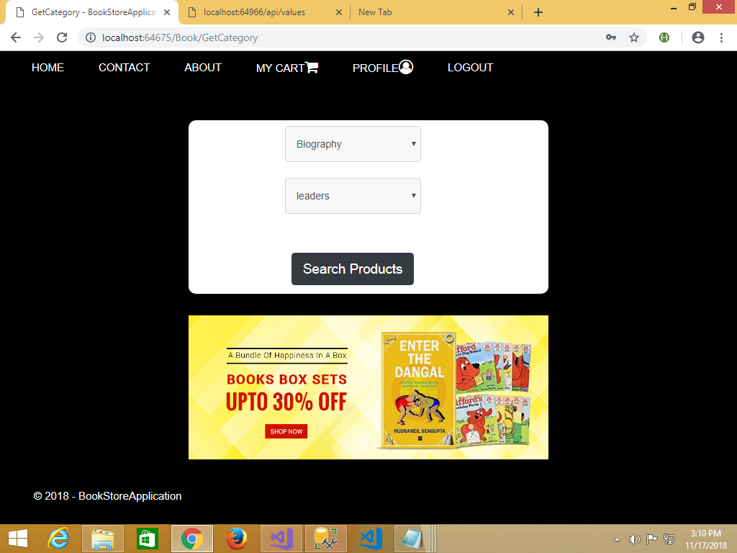
Search

Slide 19
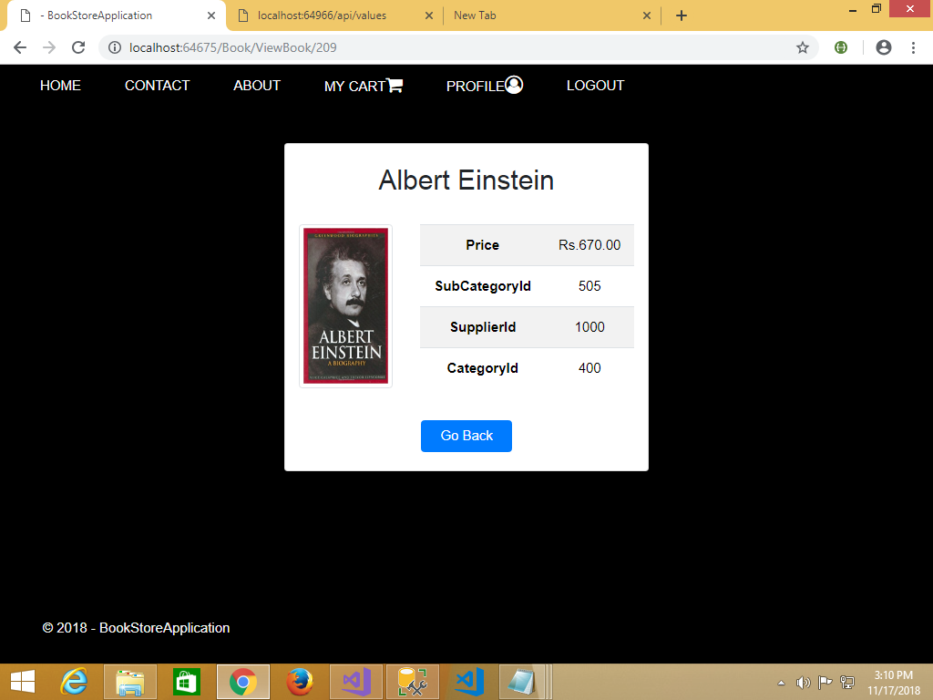
View Book

Slide 20
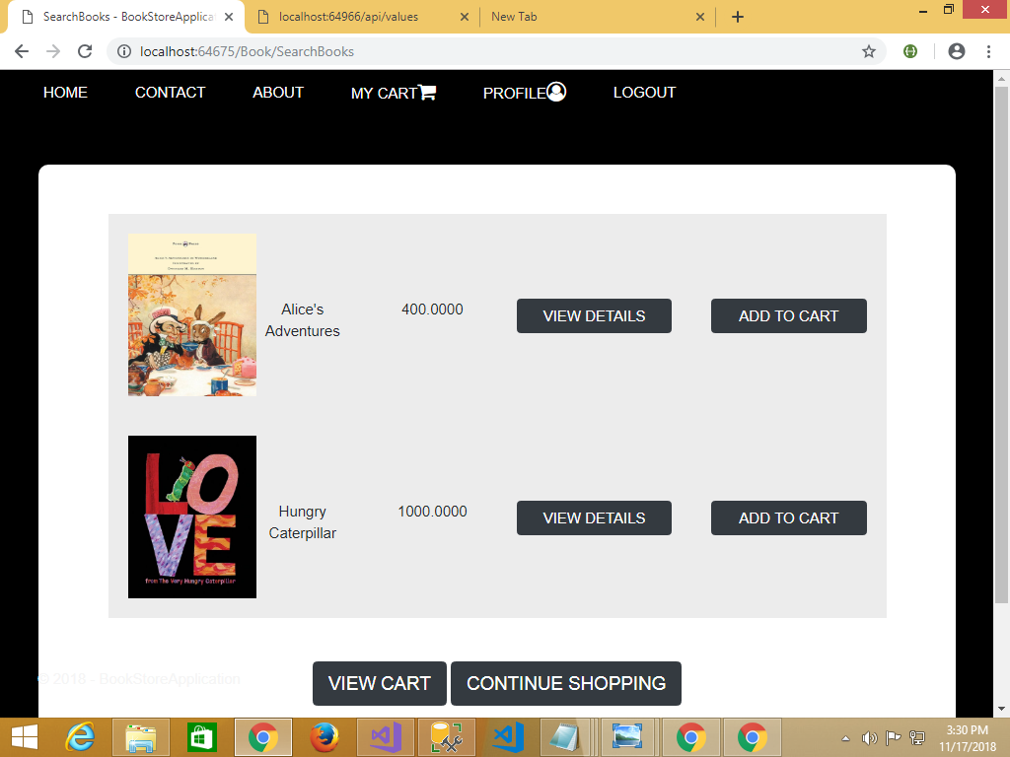
Add to Cart

Slide 21
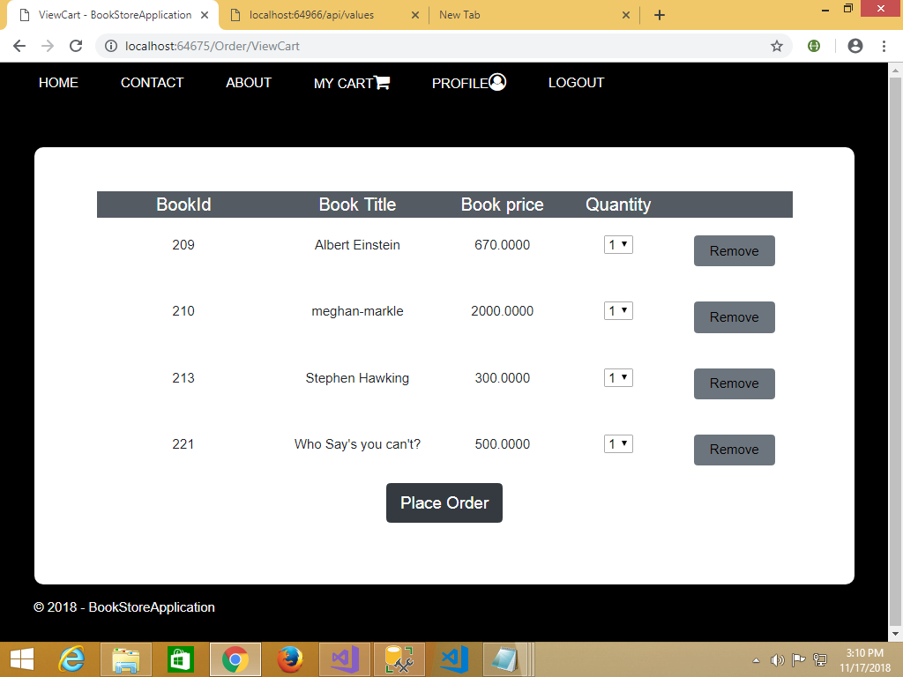
Update Cart

Slide 22
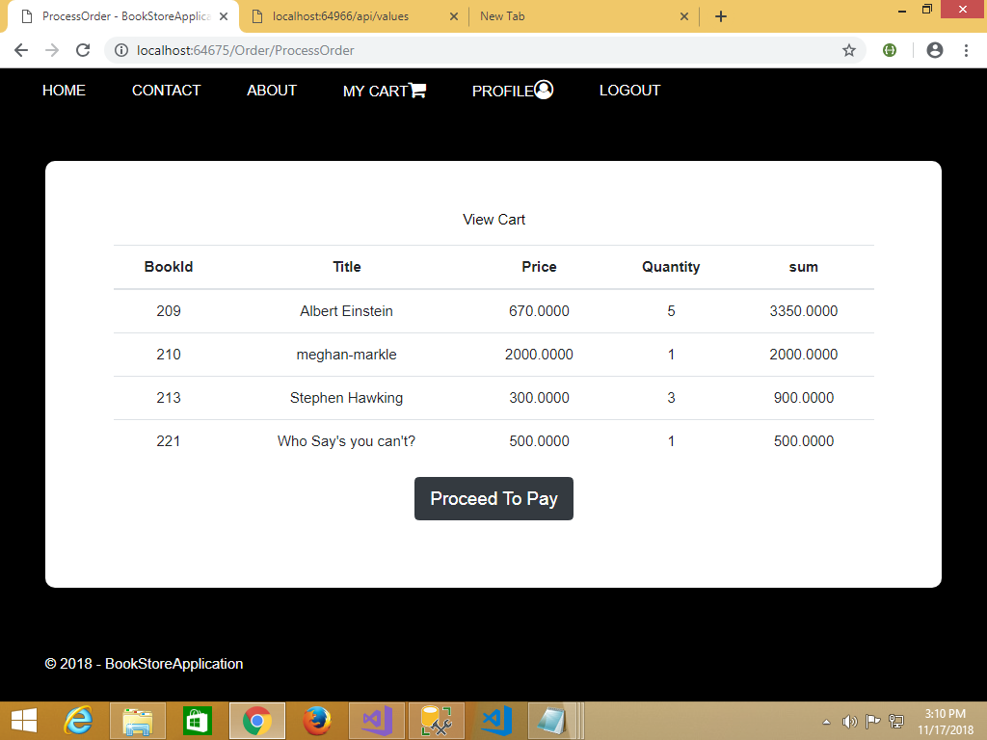
Checkout

Slide 23
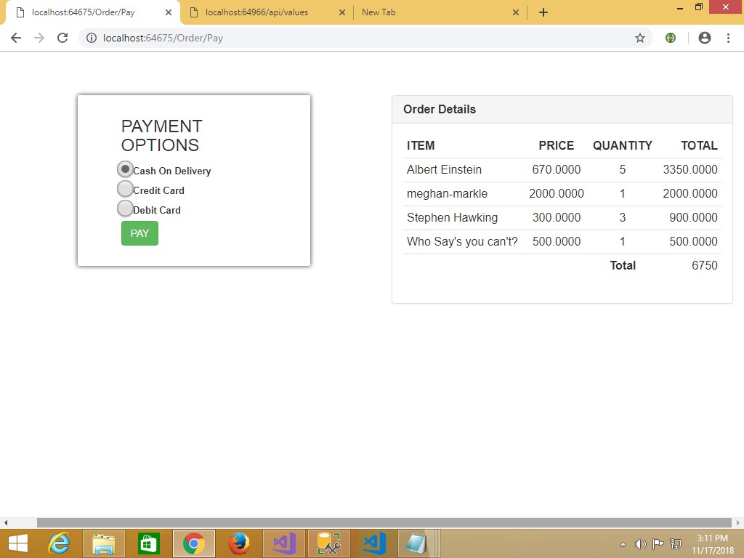
Payment Mode

Slide 24
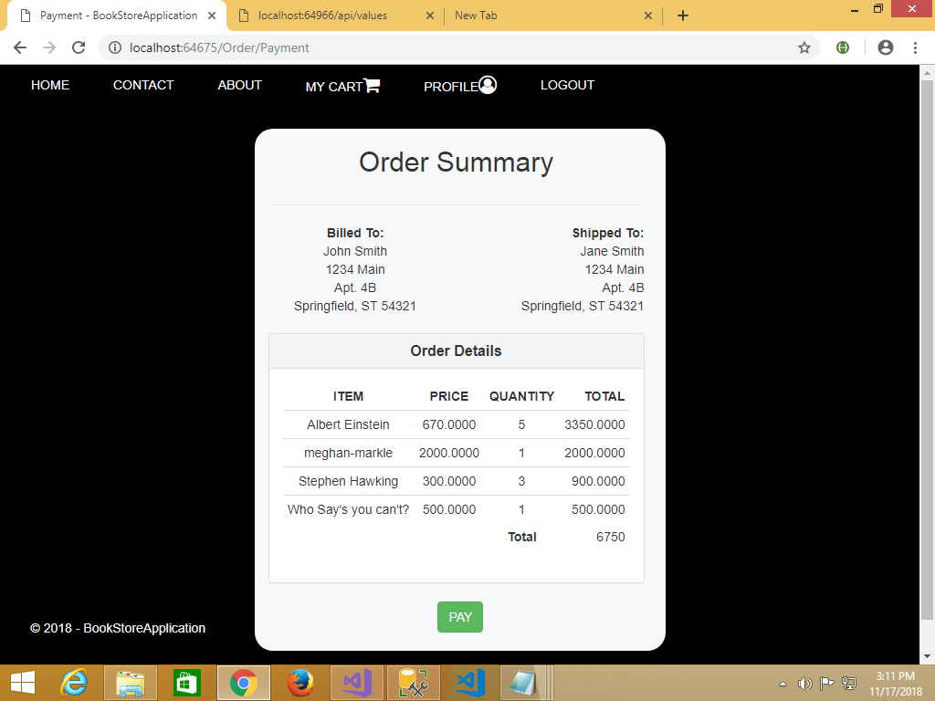
Make Payment

Slide 25
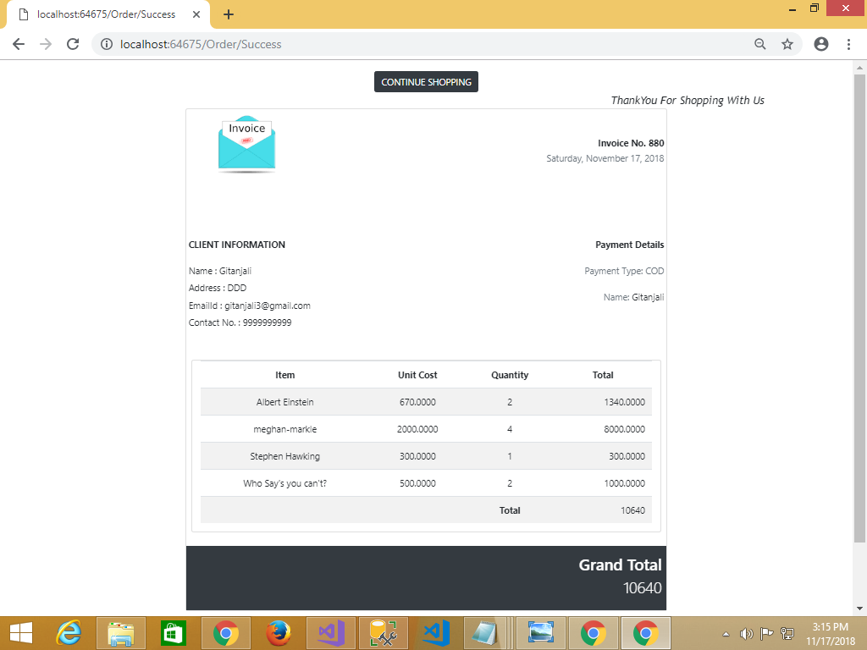
Invoice Generation

Slide 26
CONCLUSION
This project has been developed successfully and the performance of the system has been found satisfactory.
Use of the interface helps customer in having immediate information about books and order books without wasting their precious time.
User friendly interface.

Slide 27
FUTURE SCOPE
In future the software can be modified to a responsive design.
We will implement hashing to encrypt and store password securely.
We will try to implement the forgot password feature.
We will make the website more feasible by adding books in more than one category.

Slide 28
References
Web References
https://stackoverflow.com/ (accessed on 16/03/2018)
https://www.w3schools.com/bootstrap/default.asp (accessed on 17/02/2018)
https://fontawesome.com/v4.7.0/icons/ (accessed on 02/02/2018)
https://jsfiddle.net/ (accessed on 16/03/2018)
https://msdn.Microsoft.com
Book References
Black Book C# programming
Head First JavaScript Book
Learn MVC project in 7 Days

Slide 29
THANK YOU

